Slide 1

Notes:
This template is for educational, non-commercial purposes only. For more free game templates like this one, visit https://www.taysteachingtoolkit.com

Slide 2

CHOOSE A LETTER &
ANSWER A QUESTION.

Slide 3
IF YOU’RE RIGHT, YOU
CAN PLAY A CARD GAME
FOR POINTS!

Slide 4


I WILL SHOW YOU A CARD.
+4 POINTS
+4 POINTS

Slide 5
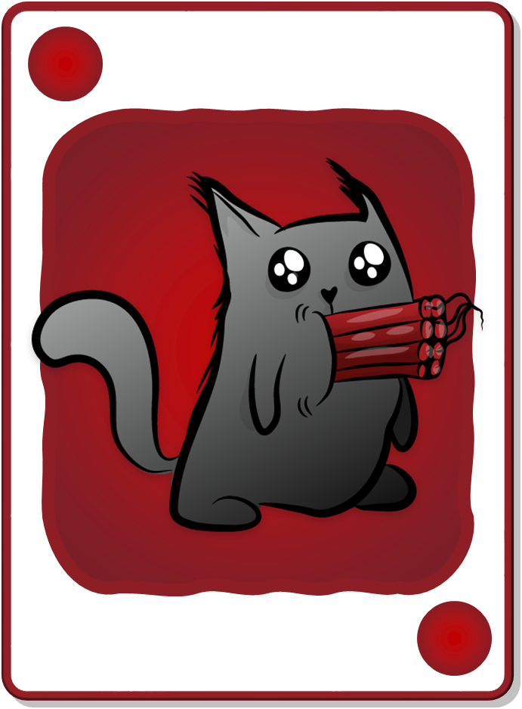

KEEP THE POINTS ON THE CARD OR
DRAW AGAIN FOR MORE POINTS!
+2 POINTS
+4 POINTS
Take 6 points
Take 4 points
Draw again
+4 POINTS
+2 POINTS

Slide 6
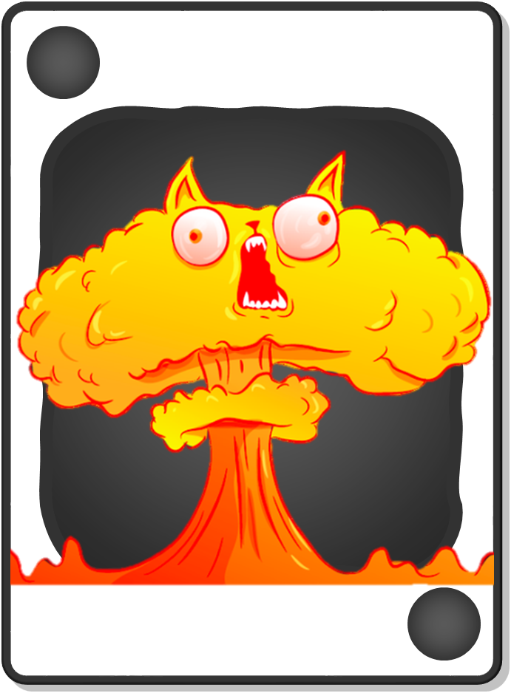
BEWARE! IF YOU FIND A BOMB, YOU GET 0 POINTS & THE GAME IS OVER.
+2 POINTS
BOMB!
Take 6 points
Draw again
+2 POINTS
BOMB!
Notes:
game over = their turn is over and they get no points for their turn

Slide 7

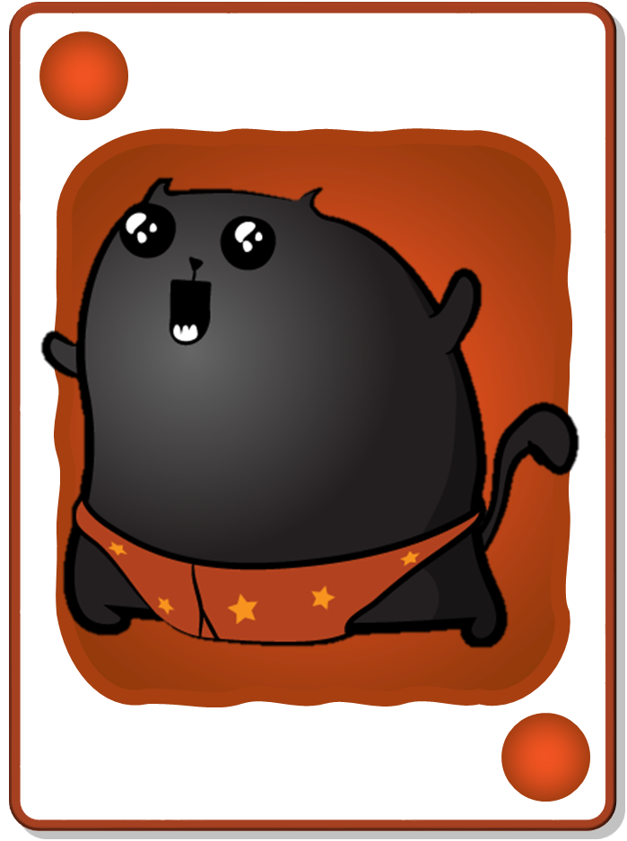
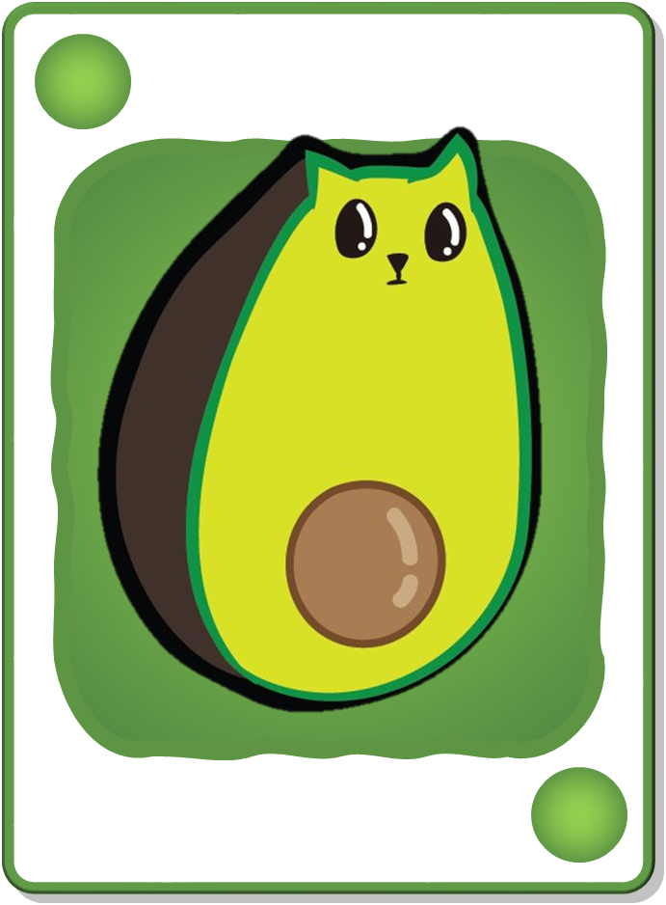

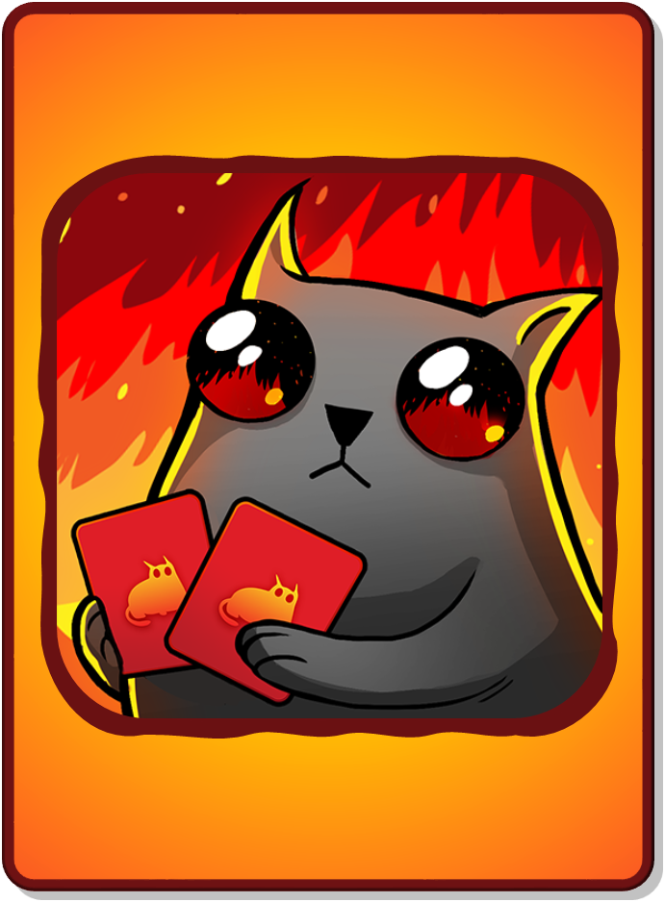

DECK CARDS
+1 POINT
+2 POINTS
+3 POINTS
+4 POINTS
+5 POINTS
BOMB!
NUCLEAR!
+1 POINT
+2 POINTS
+3 POINTS
+4 POINTS
+5 POINTS
BOMB!
NUCLEAR!
All teams lose
all points!
LOSE ALL POINTS!
CHANGE POINTS!
Only your
team loses all
their points!
RARE CARDS
(not in deck)
LSOE ALL POINTS!
CHANGE POINTS!
Notes:
“Rare cards” cannot be found in the decks where students accumulate points. They’re a separate reward event (see reward slides for details).

Slide 8

1
2
3
4
CHOOSE A NUMBER
5
6
7
8
9
10
11
12
13
14
Notes:
A student/team chooses a letter.
Click the letter they choose to go to the corresponding question slide.

Slide 9





Question?
One steak is $375
How much are two steaks?
They’re 750 dollars.
Notes:
Click the spacebar to make the ANSWER appear.
The blank space in the middle is for any extra text/images you need.
Click the green button to go to the reward slide.
Click the red button to go back to the question-choosing slide.
Background wood texture by vector.satrian on https://www.vecteezy.com

Slide 10
Question?
What is the past tense for “are”?
Were
Notes:
Click the spacebar to make the ANSWER appear.
The blank space in the middle is for any extra text/images you need.
Click the green button to go to the reward slide.
Click the red button to go back to the question-choosing slide.
Background wood texture by vector.satrian on https://www.vecteezy.com

Slide 11
Question?
Unscramble the word:
ootthhace
toothache
Notes:
Click the spacebar to make the ANSWER appear.
The blank space in the middle is for any extra text/images you need.
Click the green button to go to the reward slide.
Click the red button to go back to the question-choosing slide.
Background wood texture by vector.satrian on https://www.vecteezy.com

Slide 12
Question?
Complete the sentence:
What’s _____? Do _____ have a fever?
wrong, you
Notes:
Click the spacebar to make the ANSWER appear.
The blank space in the middle is for any extra text/images you need.
Click the green button to go to the reward slide.
Click the red button to go back to the question-choosing slide.
Background wood texture by vector.satrian on https://www.vecteezy.com

Slide 13
Question?
Did they enjoy the picnic yesterday?
Yes, they did.
No, they didn’t enjoy the picnic.
Yes, they enjoyed the picnic.
Notes:
Click the spacebar to make the ANSWER appear.
The blank space in the middle is for any extra text/images you need.
Click the green button to go to the reward slide.
Click the red button to go back to the question-choosing slide.
Background wood texture by vector.satrian on https://www.vecteezy.com

Slide 14
Question?
Where did you go yesterday?
I went to ________ , yesterday.
Notes:
Click the spacebar to make the ANSWER appear.
The blank space in the middle is for any extra text/images you need.
Click the green button to go to the reward slide.
Click the red button to go back to the question-choosing slide.
Background wood texture by vector.satrian on https://www.vecteezy.com

Slide 15
Question?
Unscramble the word:
plmiundgs
Dumplings
Notes:
Click the spacebar to make the ANSWER appear.
The blank space in the middle is for any extra text/images you need.
Click the green button to go to the reward slide.
Click the red button to go back to the question-choosing slide.
Background wood texture by vector.satrian on https://www.vecteezy.com

Slide 16
Question?
What time does she go to bed every day?
She goes to bed at ___ every day.
Notes:
Click the spacebar to make the ANSWER appear.
The blank space in the middle is for any extra text/images you need.
Click the green button to go to the reward slide.
Click the red button to go back to the question-choosing slide.
Background wood texture by vector.satrian on https://www.vecteezy.com

Slide 17

Question?
In which country is Mount Fuji?
JAPAN
Notes:
Click the spacebar to make the ANSWER appear.
The blank space in the middle is for any extra text/images you need.
Click the green button to go to the reward slide.
Click the red button to go back to the question-choosing slide.
Background wood texture by vector.satrian on https://www.vecteezy.com

Slide 18
Question
May I have two _______ of water, please?
glasses / bottles
Notes:
Click the spacebar to make the ANSWER appear.
The blank space in the middle is for any extra text/images you need.
Click the green button to go to the reward slide.
Click the red button to go back to the question-choosing slide.
Background wood texture by vector.satrian on https://www.vecteezy.com

Slide 19
Question?
What do you do on weekends?
I ____ on weekends.
Notes:
Click the spacebar to make the ANSWER appear.
The blank space in the middle is for any extra text/images you need.
Click the green button to go to the reward slide.
Click the red button to go back to the question-choosing slide.
Background wood texture by vector.satrian on https://www.vecteezy.com

Slide 20
Question?
Name 5 foods that you like to eat.
Noodles, steak, rice…
Notes:
Click the spacebar to make the ANSWER appear.
The blank space in the middle is for any extra text/images you need.
Click the green button to go to the reward slide.
Click the red button to go back to the question-choosing slide.
Background wood texture by vector.satrian on https://www.vecteezy.com

Slide 21

Bonus question.
What does Amy do every night?
She watches TV every night.
Notes:
Click the spacebar to make the ANSWER appear.
The blank space in the middle is for any extra text/images you need.
Click the green button to go to the reward slide.
Click the red button to go back to the question-choosing slide.
Background wood texture by vector.satrian on https://www.vecteezy.com

Slide 22

Bonus question.
What time does Jane wake up every day?
She wakes up at 6:45 every day.
Notes:
Click the spacebar to make the ANSWER appear.
The blank space in the middle is for any extra text/images you need.
Click the green button to go to the reward slide.
Click the red button to go back to the question-choosing slide.
Background wood texture by vector.satrian on https://www.vecteezy.com

Slide 23

+4 POINTS
+1 POINT
BOMB!
+3 POINTS
Total Points:
0
3
7
8
+3 POINTS
+1 POINT
+4 POINTS
BOMB!
Notes:
Press the spacebar to reveal the first card.
Ask the student/team if they want to take the total points they have so far or draw again to possibly add more points.
I usually have my students say “keep going” (draw again) or “stop” (take the points they’ve accumulated).
Repeat this process until they either decide to take their accumulated points or reach a Bomb or Nuclear card.
Click the ABC Cat icon in the right-hand corner to go back the question-choosing slide.
Background wood texture by vector.satrian on https://www.vecteezy.com

Slide 24
NUCLEAR!
+2 POINTS
+1 POINT
+1 POINT
+3 POINTS
Total Points:
0
3
4
5
7
+3 POINTS
+1 POINT
+1 POINT
NUCLEAR!
+2 POINTS
Notes:
Press the spacebar to reveal the first card.
Ask the student/team if they want to take the total points they have so far or draw again to possibly add more points.
I usually have my students say “keep going” (draw again) or “stop” (take the points they’ve accumulated).
Repeat this process until they either decide to take their accumulated points or reach a Bomb or Nuclear card.
Click the ABC Cat icon in the right-hand corner to go back the question-choosing slide.
Background wood texture by vector.satrian on https://www.vecteezy.com

Slide 25
+2 POINTS
BOMB!
+3 POINTS
Total Points:
0
3
5
+3 POINTS
+2 POINTS
BOMB!
Notes:
Press the spacebar to reveal the first card.
Ask the student/team if they want to take the total points they have so far or draw again to possibly add more points.
I usually have my students say “keep going” (draw again) or “stop” (take the points they’ve accumulated).
Repeat this process until they either decide to take their accumulated points or reach a Bomb or Nuclear card.
Click the ABC Cat icon in the right-hand corner to go back the question-choosing slide.
Background wood texture by vector.satrian on https://www.vecteezy.com

Slide 26


CHANGE POINTS!
YOU FOUND A RARE CARD!
Reveal it or get
5 points?
CHANGE POINTS!
Notes:
The student/team has a choice: They can either get 5 points or take a chance and reveal the rare card, from which they will either lose all their points or get to change points with another team.
Press the spacebar to reveal the card, if they choose that option.
Click the ABC Cat icon in the right-hand corner to go back the question-choosing slide.
Background wood texture by vector.satrian on https://www.vecteezy.com

Slide 27
+2 POINTS
+1 POINT
+1 POINT
+1 POINT
+5 POINTS
BOMB!
Total Points:
10
0
1
6
7
9
+5 POINTS
+1 POINT
+1 POINT
+1 POINT
+2 POINTS
BOMB!
Notes:
Press the spacebar to reveal the first card.
Ask the student/team if they want to take the total points they have so far or draw again to possibly add more points.
I usually have my students say “keep going” (draw again) or “stop” (take the points they’ve accumulated).
Repeat this process until they either decide to take their accumulated points or reach a Bomb or Nuclear card.
Click the ABC Cat icon in the right-hand corner to go back the question-choosing slide.
Background wood texture by vector.satrian on https://www.vecteezy.com

Slide 28
NUCLEAR!
+2 POINTS
+2 POINTS
+5 POINTS
+3 POINTS
Total Points:
12
0
2
7
9
+5 POINTS
+3 POINTS
NUCLEAR!
+2 POINTS
+2 POINTS
Notes:
Press the spacebar to reveal the first card.
Ask the student/team if they want to take the total points they have so far or draw again to possibly add more points.
I usually have my students say “keep going” (draw again) or “stop” (take the points they’ve accumulated).
Repeat this process until they either decide to take their accumulated points or reach a Bomb or Nuclear card.
Click the ABC Cat icon in the right-hand corner to go back the question-choosing slide.
Background wood texture by vector.satrian on https://www.vecteezy.com

Slide 29
+2 POINTS
+2 POINTS
+2 POINTS
+2 POINTS
+1 POINT
BOMB!
+3 POINTS
Total Points:
12
0
2
4
6
7
9
+3 POINTS
+1 POINT
+2 POINTS
+2 POINTS
+2 POINTS
+2 POINTS
BOMB!
Notes:
Press the spacebar to reveal the first card.
Ask the student/team if they want to take the total points they have so far or draw again to possibly add more points.
I usually have my students say “keep going” (draw again) or “stop” (take the points they’ve accumulated).
Repeat this process until they either decide to take their accumulated points or reach a Bomb or Nuclear card.
Click the ABC Cat icon in the right-hand corner to go back the question-choosing slide.
Background wood texture by vector.satrian on https://www.vecteezy.com

Slide 30
+4 POINTS
BOMB!
Total Points:
0
4
+4 POINTS
BOMB!
Notes:
Press the spacebar to reveal the first card.
Ask the student/team if they want to take the total points they have so far or draw again to possibly add more points.
I usually have my students say “keep going” (draw again) or “stop” (take the points they’ve accumulated).
Repeat this process until they either decide to take their accumulated points or reach a Bomb or Nuclear card.
Click the ABC Cat icon in the right-hand corner to go back the question-choosing slide.
Background wood texture by vector.satrian on https://www.vecteezy.com

Slide 31
LOSE ALL POINTS!
YOU FOUND A RARE CARD!
Reveal it or get
5 points?
LSOE ALL POINTS!
Notes:
The student/team has a choice: They can either get 5 points or take a chance and reveal the rare card, from which they will either lose all their points or get to change points with another team.
Press the spacebar to reveal the card, if they choose that option.
Click the ABC Cat icon in the right-hand corner to go back the question-choosing slide.
Background wood texture by vector.satrian on https://www.vecteezy.com

Slide 32
+4 POINTS
BOMB!
+3 POINTS
+3 POINTS
Total Points:
10
0
3
7
+3 POINTS
+3 POINTS
+4 POINTS
BOMB!
Notes:
Press the spacebar to reveal the first card.
Ask the student/team if they want to take the total points they have so far or draw again to possibly add more points.
I usually have my students say “keep going” (draw again) or “stop” (take the points they’ve accumulated).
Repeat this process until they either decide to take their accumulated points or reach a Bomb or Nuclear card.
Click the ABC Cat icon in the right-hand corner to go back the question-choosing slide.
Background wood texture by vector.satrian on https://www.vecteezy.com

Slide 33
+4 POINTS
+2 POINTS
BOMB!
+3 POINTS
Total Points:
0
3
7
9
+3 POINTS
+4 POINTS
+2 POINTS
BOMB!
Notes:
Press the spacebar to reveal the first card.
Ask the student/team if they want to take the total points they have so far or draw again to possibly add more points.
I usually have my students say “keep going” (draw again) or “stop” (take the points they’ve accumulated).
Repeat this process until they either decide to take their accumulated points or reach a Bomb or Nuclear card.
Click the ABC Cat icon in the right-hand corner to go back the question-choosing slide.
Background wood texture by vector.satrian on https://www.vecteezy.com

Slide 34
CHANGE POINTS!
YOU FOUND A RARE CARD!
Reveal it or get
5 points?
CHANGE POINTS!
Notes:
The student/team has a choice: They can either get 5 points or take a chance and reveal the rare card, from which they will either lose all their points or get to change points with another team.
Press the spacebar to reveal the card, if they choose that option.
Click the ABC Cat icon in the right-hand corner to go back the question-choosing slide.
Background wood texture by vector.satrian on https://www.vecteezy.com

Slide 35
NUCLEAR!
+4 POINTS
+2 POINTS
+2 POINTS
+1 POINT
+3 POINTS
+3 POINTS
Total Points:
15
12
0
2
6
7
9
+3 POINTS
+3 POINTS
+1 POINT
+4 POINTS
NUCLEAR!
+2 POINTS
+2 POINTS
Notes:
Press the spacebar to reveal the first card.
Ask the student/team if they want to take the total points they have so far or draw again to possibly add more points.
I usually have my students say “keep going” (draw again) or “stop” (take the points they’ve accumulated).
Repeat this process until they either decide to take their accumulated points or reach a Bomb or Nuclear card.
Click the ABC Cat icon in the right-hand corner to go back the question-choosing slide.
Background wood texture by vector.satrian on https://www.vecteezy.com

Slide 36
+5 POINTS
BOMB!
Total Points:
0
5
+5 POINTS
BOMB!
Notes:
Press the spacebar to reveal the first card.
Ask the student/team if they want to take the total points they have so far or draw again to possibly add more points.
I usually have my students say “keep going” (draw again) or “stop” (take the points they’ve accumulated).
Repeat this process until they either decide to take their accumulated points or reach a Bomb or Nuclear card.
Click the ABC Cat icon in the right-hand corner to go back the question-choosing slide.
Background wood texture by vector.satrian on https://www.vecteezy.com

Slide 37
+4 POINTS
+2 POINTS
+1 POINT
+5 POINTS
BOMB!
Total Points:
12
0
1
3
8
+5 POINTS
+1 POINT
+4 POINTS
+2 POINTS
BOMB!
Notes:
Press the spacebar to reveal the first card.
Ask the student/team if they want to take the total points they have so far or draw again to possibly add more points.
I usually have my students say “keep going” (draw again) or “stop” (take the points they’ve accumulated).
Repeat this process until they either decide to take their accumulated points or reach a Bomb or Nuclear card.
Click the ABC Cat icon in the right-hand corner to go back the question-choosing slide.
Background wood texture by vector.satrian on https://www.vecteezy.com

Slide 38
LOSE ALL POINTS!
YOU FOUND A RARE CARD!
Reveal it or get
5 points?
LSOE ALL POINTS!
Notes:
The student/team has a choice: They can either get 5 points or take a chance and reveal the rare card, from which they will either lose all their points or get to change points with another team.
Press the spacebar to reveal the card, if they choose that option.
Click the ABC Cat icon in the right-hand corner to go back the question-choosing slide.
Background wood texture by vector.satrian on https://www.vecteezy.com

Slide 39
LOSE ALL POINTS!
YOU FOUND A RARE CARD!
Reveal it or get
5 points?
LSOE ALL POINTS!
Notes:
The student/team has a choice: They can either get 5 points or take a chance and reveal the rare card, from which they will either lose all their points or get to change points with another team.
Press the spacebar to reveal the card, if they choose that option.
Click the ABC Cat icon in the right-hand corner to go back the question-choosing slide.
Background wood texture by vector.satrian on https://www.vecteezy.com

Slide 40
+2 POINTS
+2 POINTS
BOMB!
Total Points:
0
2
4
+2 POINTS
+2 POINTS
BOMB!
Notes:
Press the spacebar to reveal the first card.
Ask the student/team if they want to take the total points they have so far or draw again to possibly add more points.
I usually have my students say “keep going” (draw again) or “stop” (take the points they’ve accumulated).
Repeat this process until they either decide to take their accumulated points or reach a Bomb or Nuclear card.
Click the ABC Cat icon in the right-hand corner to go back the question-choosing slide.
Background wood texture by vector.satrian on https://www.vecteezy.com

Slide 41
NUCLEAR!
+4 POINTS
+2 POINTS
+1 POINT
+5 POINTS
+3 POINTS
Total Points:
15
14
11
0
5
7
+5 POINTS
+3 POINTS
+1 POINT
+4 POINTS
NUCLEAR!
+2 POINTS
Notes:
Press the spacebar to reveal the first card.
Ask the student/team if they want to take the total points they have so far or draw again to possibly add more points.
I usually have my students say “keep going” (draw again) or “stop” (take the points they’ve accumulated).
Repeat this process until they either decide to take their accumulated points or reach a Bomb or Nuclear card.
Click the ABC Cat icon in the right-hand corner to go back the question-choosing slide.
Background wood texture by vector.satrian on https://www.vecteezy.com

Slide 42
+1 POINT
+1 POINT
+1 POINT
BOMB!
Total Points:
0
1
2
3
+1 POINT
+1 POINT
+1 POINT
BOMB!
Notes:
Press the spacebar to reveal the first card.
Ask the student/team if they want to take the total points they have so far or draw again to possibly add more points.
I usually have my students say “keep going” (draw again) or “stop” (take the points they’ve accumulated).
Repeat this process until they either decide to take their accumulated points or reach a Bomb or Nuclear card.
Click the ABC Cat icon in the right-hand corner to go back the question-choosing slide.
Background wood texture by vector.satrian on https://www.vecteezy.com

Slide 43
+2 POINTS
+2 POINTS
+1 POINT
+5 POINTS
BOMB!
+3 POINTS
+3 POINTS
Total Points:
10
11
16
0
2
4
7
+5 POINTS
+3 POINTS
+3 POINTS
+1 POINT
+2 POINTS
+2 POINTS
BOMB!
Notes:
Press the spacebar to reveal the first card.
Ask the student/team if they want to take the total points they have so far or draw again to possibly add more points.
I usually have my students say “keep going” (draw again) or “stop” (take the points they’ve accumulated).
Repeat this process until they either decide to take their accumulated points or reach a Bomb or Nuclear card.
Click the ABC Cat icon in the right-hand corner to go back the question-choosing slide.
Background wood texture by vector.satrian on https://www.vecteezy.com

Slide 44
CHANGE POINTS!
YOU FOUND A RARE CARD!
Reveal it or get
5 points?
CHANGE POINTS!
Notes:
The student/team has a choice: They can either get 5 points or take a chance and reveal the rare card, from which they will either lose all their points or get to change points with another team.
Press the spacebar to reveal the card, if they choose that option.
Click the ABC Cat icon in the right-hand corner to go back the question-choosing slide.
Background wood texture by vector.satrian on https://www.vecteezy.com

Slide 45
NUCLEAR!
+5 POINTS
+5 POINTS
+3 POINTS
Total Points:
10
13
0
5
+5 POINTS
+5 POINTS
+3 POINTS
NUCLEAR!
Notes:
Press the spacebar to reveal the first card.
Ask the student/team if they want to take the total points they have so far or draw again to possibly add more points.
I usually have my students say “keep going” (draw again) or “stop” (take the points they’ve accumulated).
Repeat this process until they either decide to take their accumulated points or reach a Bomb or Nuclear card.
Click the ABC Cat icon in the right-hand corner to go back the question-choosing slide.
Background wood texture by vector.satrian on https://www.vecteezy.com

Slide 46
+4 POINTS
+2 POINTS
+2 POINTS
+1 POINT
+1 POINT
+1 POINT
+1 POINT
+5 POINTS
BOMB!
+3 POINTS
Total Points:
20
13
18
11
12
19
0
3
5
7
+5 POINTS
+3 POINTS
+1 POINT
+1 POINT
+1 POINT
+1 POINT
+4 POINTS
+2 POINTS
+2 POINTS
BOMB!
Notes:
Press the spacebar to reveal the first card.
Ask the student/team if they want to take the total points they have so far or draw again to possibly add more points.
I usually have my students say “keep going” (draw again) or “stop” (take the points they’ve accumulated).
Repeat this process until they either decide to take their accumulated points or reach a Bomb or Nuclear card.
Click the ABC Cat icon in the right-hand corner to go back the question-choosing slide.
Background wood texture by vector.satrian on https://www.vecteezy.com

Slide 47
LOSE ALL POINTS!
YOU FOUND A RARE CARD!
Reveal it or get
5 points?
LSOE ALL POINTS!
Notes:
The student/team has a choice: They can either get 5 points or take a chance and reveal the rare card, from which they will either lose all their points or get to change points with another team.
Press the spacebar to reveal the card, if they choose that option.
Click the ABC Cat icon in the right-hand corner to go back the question-choosing slide.
Background wood texture by vector.satrian on https://www.vecteezy.com

Slide 48
+2 POINTS
+5 POINTS
BOMB!
+3 POINTS
Total Points:
10
0
5
7
+5 POINTS
+3 POINTS
+2 POINTS
BOMB!
Notes:
Press the spacebar to reveal the first card.
Ask the student/team if they want to take the total points they have so far or draw again to possibly add more points.
I usually have my students say “keep going” (draw again) or “stop” (take the points they’ve accumulated).
Repeat this process until they either decide to take their accumulated points or reach a Bomb or Nuclear card.
Click the ABC Cat icon in the right-hand corner to go back the question-choosing slide.
Background wood texture by vector.satrian on https://www.vecteezy.com

